Slide 1
Infectious disease transmission in households
Caroline Walters / Ada Yan
c.walters@imperial.ac.uk
a.yan@imperial.ac.uk
Module lead: Steven Riley, s.riley@imperial.ac.uk
These slides: http://bit.ly/2CtN5PY

Slide 2
Introduction
Household: People living in the same house = population of close contacts.
SIR-type models assume homogeneous mixing - households introduce heterogeneity.
Today we will cover:
Lecture: Examples of household studies
Lecture: A simple household model (sizes 2 and 4)
Practical: Household (size 2) with temporal structure.

Slide 3
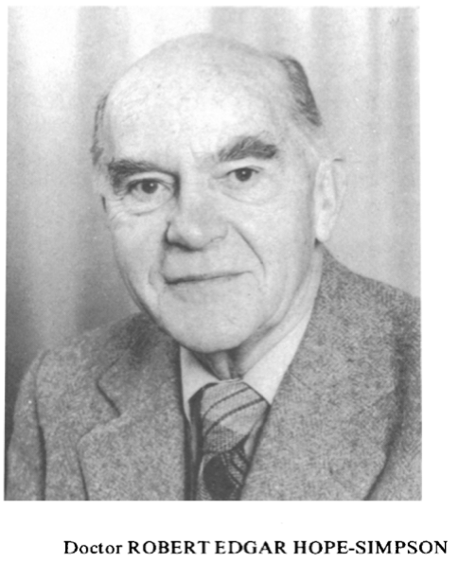
Household as a laboratory: Hope-Simpson
Landmark study on transmission of childhood infections (measles, mumps, chickenpox) (Lancet 1952, pp549-554).
https://www.sciencedirect.com/science/article/pii/S0140673652913573?via%3Dihub
(full text not available)
Established chickenpox and shingles caused by same virus (VZV) (1965 Proc R Soc Med).
https://onlinelibrary.wiley.com/doi/epdf/10.1002/rmv.337
(reprint of the original article)
Notes:
Hope-Simpson observed outbreaks in households and closed communities and systematically recorded information regarding infections and the household and community networks of individuals.
Allowed for evidence of theory that chickenpox and shingles are caused by a single virus.

Slide 4
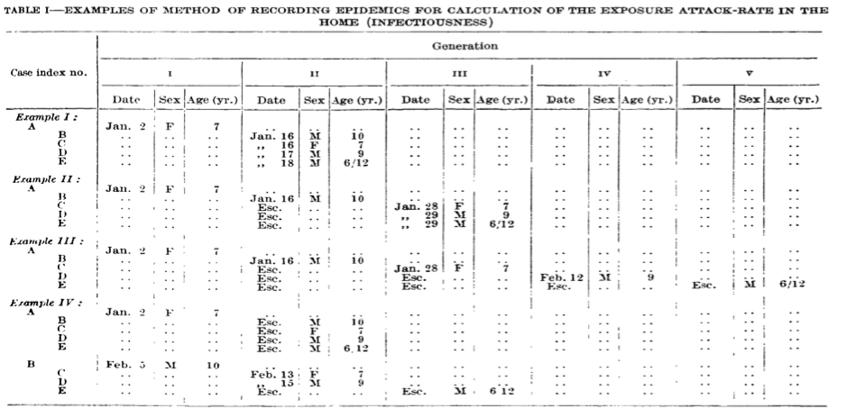
Classic study: Hope-Simpson 1952
Notes:
Hope-Simpson’s results, with rows representing different households and columns different generations of infection.
Example I: A infected, passes infection on to B, C, D, E. At that point everyone in household has had the infection.
Compare with Example II: A infects B, B infects C, D, E. So 2 subsequent generations.
Compare with Example IV: A infected on Jan 2nd - infects no one. B infected on Feb 3rd, from outside household, and goes on to infect C and D only. E escapes infections.

Slide 5
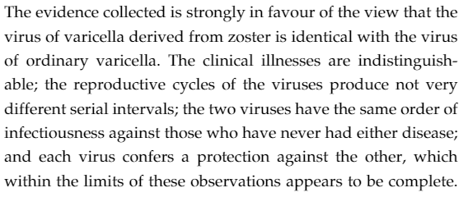
Chickenpox - shingles
chickenpox
shingles
chickenpox
(varicella)
almost-chickenpox
(Z-varicella)
Notes:
Chickenpox cases could lead to other chickenpox cases; shingles cases could lead to infections of something very similar to chickenpox.
Hypothesis at the time: varicella caused by the same organism as Z-varicella.
Hope-Simpson went to a closed community (small Shetland island of Yell) and documented case histories of shingles and chickenpox. Couldn’t use wider population as chickenpox too prevalent - couldn’t track generations of transmission. Small island population made this possible, then combined with data from his local practice (Gloucestershire) to formulate argument. Population of Yell - knew the households and also contact networks (children at school).
Argued that if varicella and Z-varicella we related but not the same then there would be cross-immunity, but not complete immunity. Found cross-protection was 100% in all cases.
In the conclusion, used some values from observations of the chickenpox, measles, mumps paper that we cannot access.

Slide 6

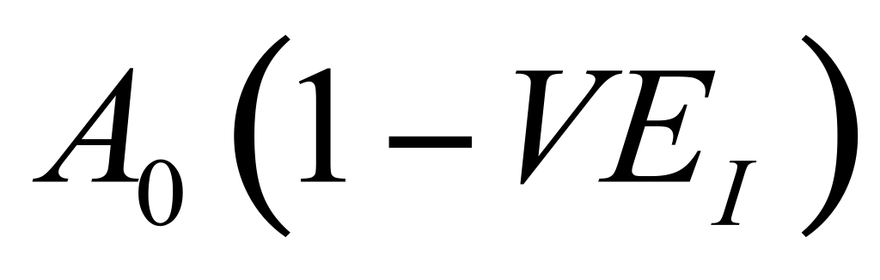
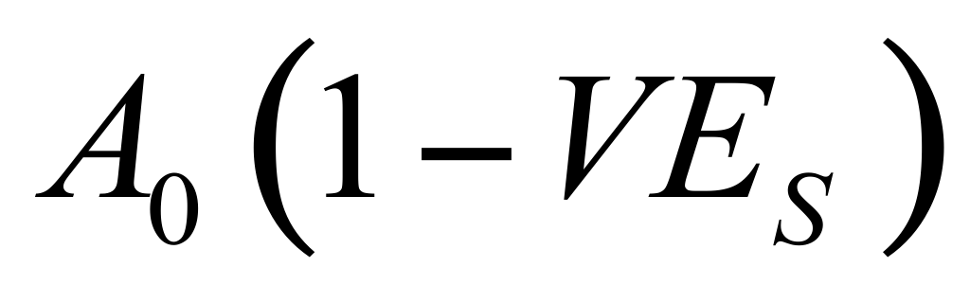
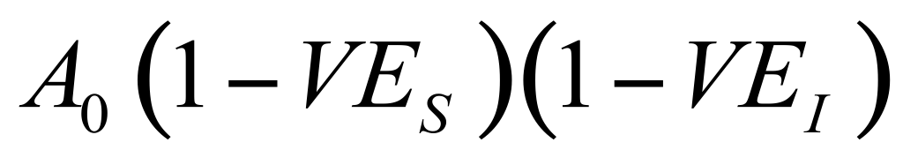
Household studies and vaccine efficacy
Immunity may be partial, affecting both susceptibility and infectiousness. Comparative household studies ideal for assessing this due to the presence of vaccine and control pairs.
Index
Secondary
control
control
vaccinee
vaccinee
(Halloran et al, JASA 2003, “Estimating vaccine efficacy from secondary attack rates”)
https://www.jstor.org/stable/30045192
Notes:
The protective efficacy of vaccination, VE_S , has been the main interest. The secondary attack rate (SAR), the proportion of susceptibles exposed to an infectious person who become infected, has been used to estimate protective effects of vaccination.
Recently, the effect of vaccination on reducing infectiousness in breakthrough cases, VE_I, based on the relative SAR from vaccinated cases compared with that from unvaccinated cases, has received more attention.
households/ clusters/ living units: can look at each unit separately and take into account the vaccination status of the infectious individual and all susceptibles. Then can calculate SAR in each unit and compare units of different vax status.

Slide 7
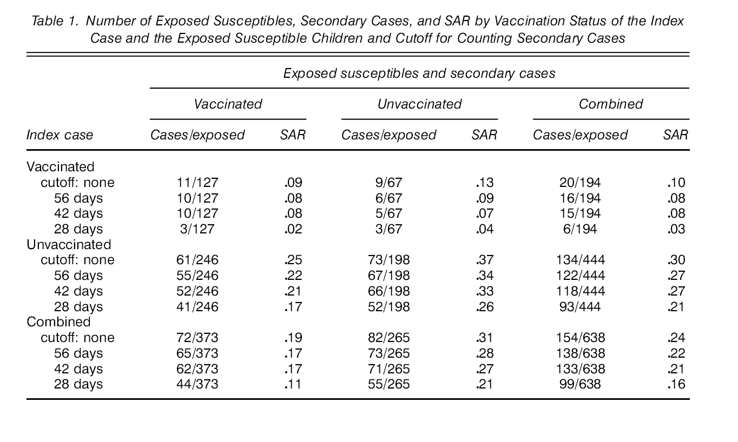
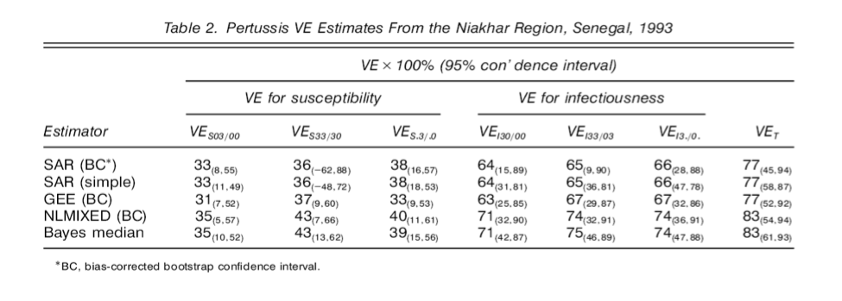
Example: pertussis vaccine (Halloran et al.)
Notes:
Again a table recording index cases and subsequent infections.

Slide 8
A simple household model
Household: unit of heterogeneity for directly transmitted infections (not sexual), core units of contact network.
Standard SIS model - homogeneous mixing
Introduce households then 2 types of mixing:
Outside the household
Within the household
Notes:
No we look at a simple household model.
Good model to look at in detail - not too complicated, can work through the steps.

Slide 9
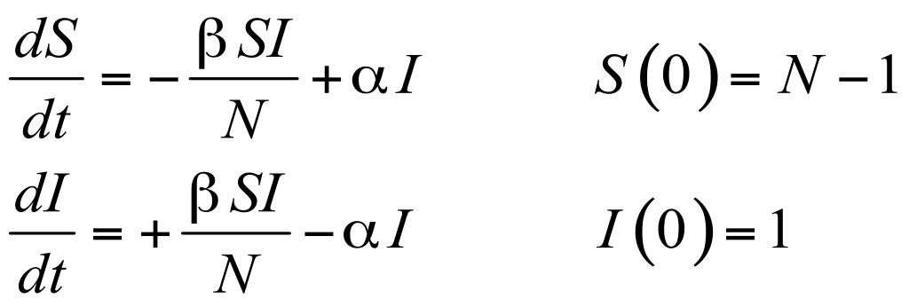
A simple household model
SIS model in 2 situations:
Homogeneously mixing population of size N;
Population of N/2 households of size 2.
Model 1:
βI/N
S
I
α
Notes:
SIS model should be familiar to you.
For simple household model, take population N and divide by size of household to give number of households.

Slide 10
A simple household model
Model 2:
Households of size 2
Random dynamic contacts
Permanent static contacts
Notes:
Split the population N into N/2 households with 2 people in each household.
There 2 people definitely interact with each other (permanent contacts), but also have a chance of interact with the population outside of their household (random contacts).

Slide 11
A simple household model
Households can be in 1 of 3 states:
Infection from random contacts
Infection from random contacts + household contacts
Susceptible
Recovery
Infectious
2β_{c}I_{t} /N
β_{h}+β_{c}I_{t} /N
SS
SI
II
α
2α
Random contact parameter β_{c}
Household contact parameter β_{h}
Notes:
SS -> SI: can only get infected from outside the household; 2 susceptibles so 2 x \beta_c I/N
SI -> II: Only 1 susceptible, can get infected from: within the household \beta_h (where we known interaction is definite); outside the household where we multiply \beta_c by I/N (chance of interacting with an infective).
\alpha is recovery rate, depends on how many infected individuals are in the household (1 or 2)

Slide 12
Developing the simple model
Today we will look at 2 developments which add complexity:
More individuals in the household - lecture
Temporal model - practical

Slide 13
4 person household
Households can be in 1 of 5 states:
3β_{h}+
4β_{h}+
3β_{h}+
SSSS
4β_{c}I_{t} /N
SSSI
3β_{c}I_{t} /N
SSII
2β_{c}I_{t} /N
SIII
β_{c}I_{t} /N
IIII
α
2α
3α
4α
Notes:
Split the population into households of size 4. Within a household, individuals are connected by a complete network ie everyone has guaranteed contact with everyone else in the household.
Similar to before:
SSSS -> SSSI: 4 x beta_c I/N
What is going on with SSII -> SIII?
Look at the number of S-I pairs.
Chance of becoming infected from within household is \beta_h x number of Inf-Sus pairs within household. Model assumption - transmissions within a household from an infective are all independent.
Chance of becoming infected from outside household is number of susceptibles x \beta_c I/N.
Recovery is \alpha x number of infecteds.

Slide 14
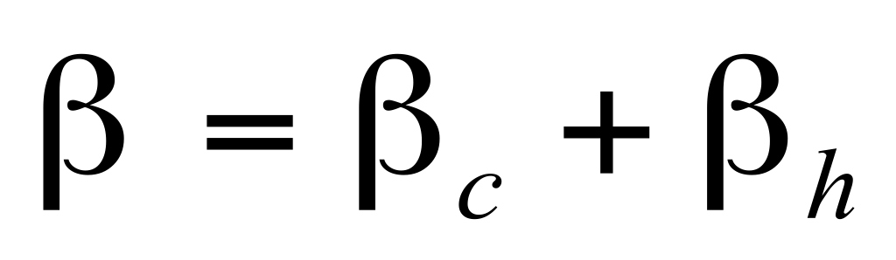
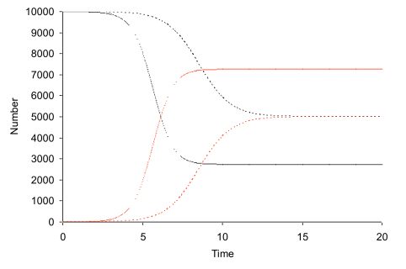
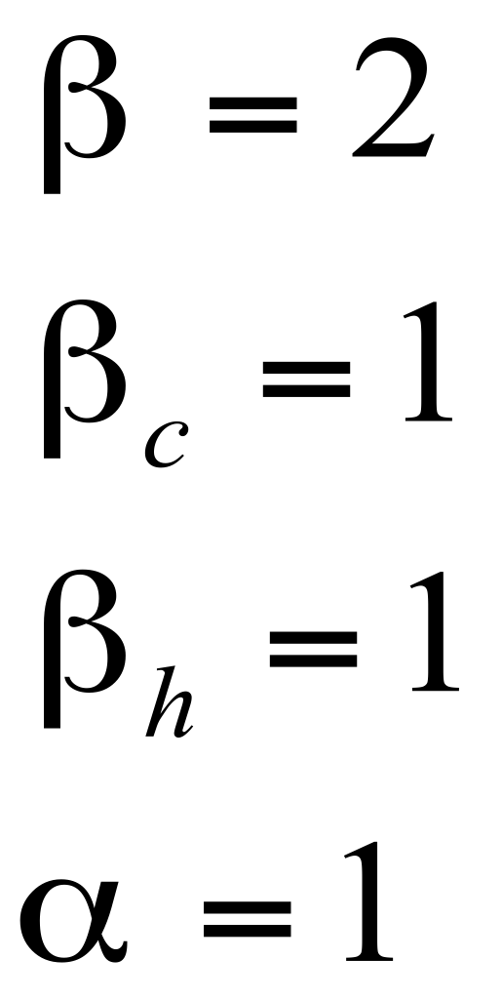
Comparison with random mixing model
Household and random mixing model can be compared in a variety of ways.
Constant contact rate, repartitioned into households and random.
Household contacts are made with all other members.
N=10,000
Household susceptible
Household infectious
Random susceptible
Random infectious
→ amplified epidemic; steeper herd effect
Notes:
We will look at some plots illustrating the different results from a random mixing model vs household model.
Potential impact:
desired interventions to slower epidemic/ treat individuals may be guided by advice from modelling. If household structure greatly impacts model predictions then optimal strategy may differ.
May be important to highlight patterns which increase our understanding of diseases (eg Hope-Simpson, VZV)
\beta is from random mixing model
\beta_c and \beta_h from household structured model
Here, \beta = \beta_c + \beta_h.
In household model: steeper curve for # infected; higher number of infecteds overall
What do you think will happen if we reduce beta_h?

Slide 15
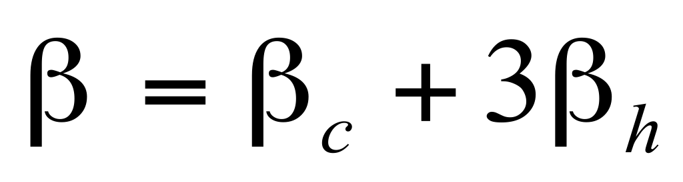
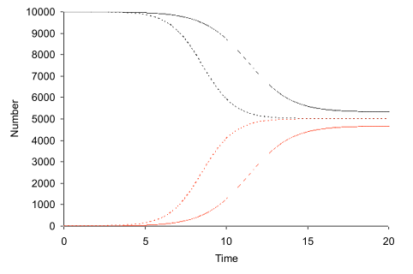
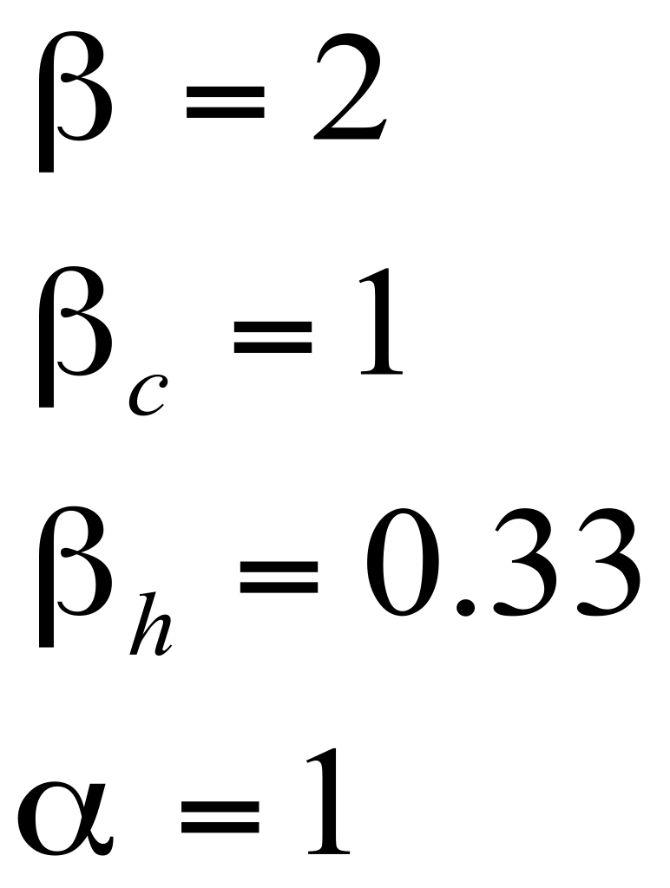
Comparison with random mixing model
2) Constant contact rate, repartitioned into households and random
Household contacts are shared between other members
N=10,000
Household susceptible
Household infectious
Random susceptible
Random infectious
→ local saturation, reduced epidemic potential
Notes:
Here, \beta = \beta_c + 3 \beta_h.
So \beta_h is lower than before.
In household model: infected curve now lower gradient; fewer infecteds overall

Slide 16
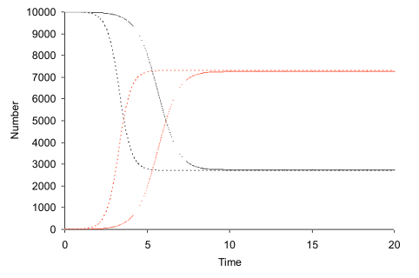
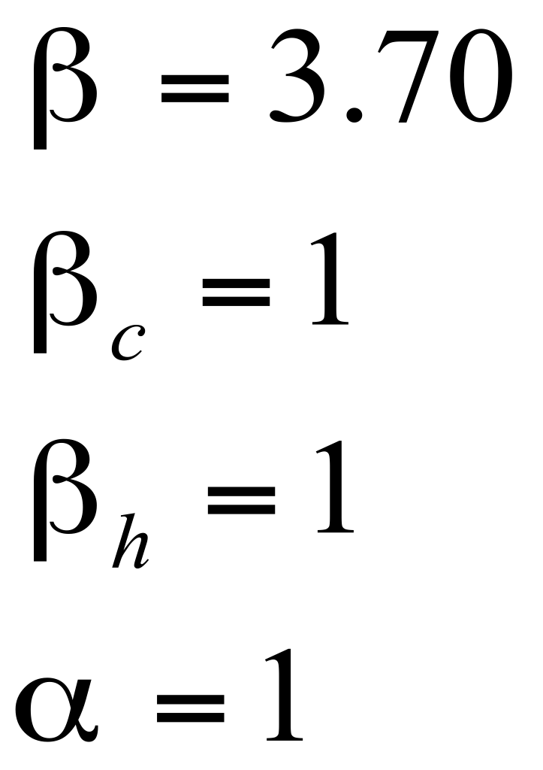
Comparison with random mixing model
3) Matched prevalence
Equivalent to R₀=3.7
N=10,000
Household susceptible
Household infectious
Random susceptible
Random infectious
→ slower epidemic, easier to eliminate
Notes:
Matching models on prevalence
In household model: slower start to epidemic; more time may allow for more effective interventions to be initiated

Slide 17
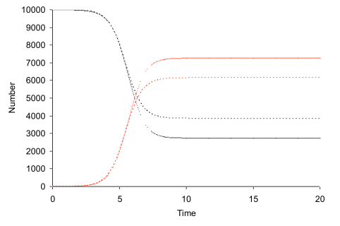
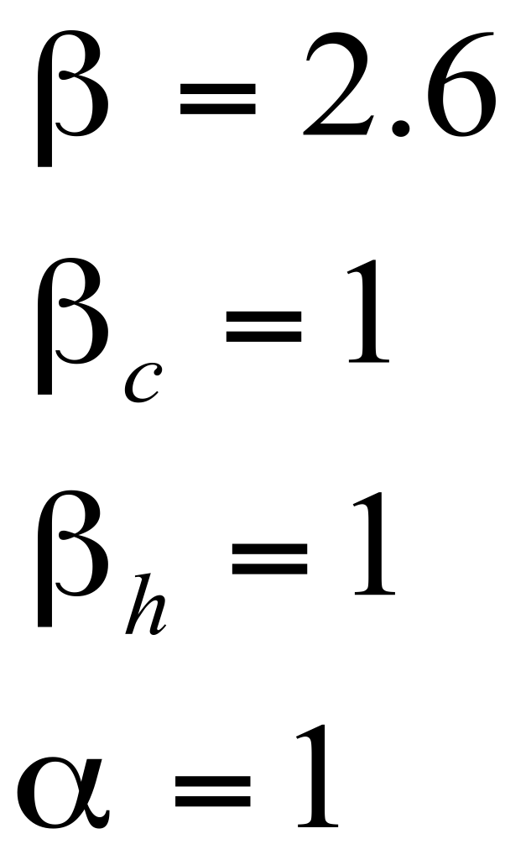
Comparison with random mixing model
4) Matched epidemic growth rate
Equivalent to R₀=2.6
N=10,000
Household susceptible
Household infectious
Random susceptible
Random infectious
→ amplified epidemic, harder to eliminate (but non-linear effect)
Notes:
Matched epi growth rate
In household model: greater prevalence.

Slide 18
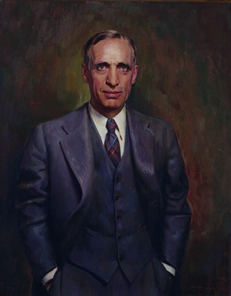
Stochasticity in outbreaks: Reed-Frost model
Unpublished model, used in teaching (with Lowell Reed), probably first mechanistic model (literally!) of direct disease transmission in 1920s (followed by Kermack-McKendrick deterministic model of 1927)
Basic assumptions:
disease transmits in generations of infection.
Probability q of not being infected by each infected, if susceptible.
Infection induces immunity.
Wade Hampton Frost 1880-1938
Notes:
Now we will look at the Reed-Frost model.
Mention assumptions

Slide 19
Modern epidemiology of the 1950s ...
http://www.youtube.com/watch?v=xYaFebO3kAU
Part 1: 1:10 - 2:10, what is an epidemic;
4:05 - 5:05, intro reed
Part 3: 1:50 - 5:00 the simulator
8:10, conclusions
Note: the video is far better than any papers that I have found. You should watch it.
(Exercise: write R code for the simulator on youtube, and email SR :) )
Notes:
Here is a link to a video of the Reed-Frost simulator. It is really good. Please watch in the lunch break/ at home. The relevant sections and times are listed here.
Model was designed for teaching in lectures, therefore the video is better than subsequent write-ups of the model. You should really watch the video.

Slide 20
Reed-Frost: example with n=4 (2)
Households of size 4. Look at infection within household. S-I-R.
At every generation: Infecteds become recovered, susceptibles become infected with some probability.
Example 1: Probability of moving from SSSI → SIIR?
3
3
OR
3
OR
3
1
2
1
2
1
2
1
2
p: probability that a single infective transmits to a single susceptible
q: (1-p), probability that a single infective does not transmit to a single susceptible
S1 not infected: q
S2 infected: p
S3 infected: p
3
3
1
2
1
2
3 possible combinations of 2 susceptibles becoming infected, so
P(SSSI → SIIR) = 3p q
2
Notes:
The model - should be accessible for all rto go through and understand, even if you have little previous modelling experience.
Now we have an S-I-R framework.
Households of size 4.
At every generation: Infecteds become recovered, susceptibles become infected with some probability.
p: probability of success (transmission) within pairs
q: fail

Slide 21
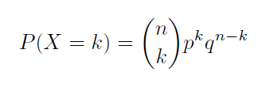
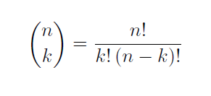

Reed-Frost: example with n=4 (2)
Transition is pmf (probability mass function) of binomial distribution:
n = number of events (susceptibles)
k = number of successes (infections)
p = probability of success
q = (1- p)
Model is analytically tractable using “chain binomials”.
Chain binomial model:
A chain of binomial distribution probability mass functions (pmfs) where each function is conditional on the previous pmf.
Notes:
The probability in the previous slide is of the form of the pmf of the binomial distribution.
n = number susceptibles
k = number of transmissions
p = probability of transmission
If we look at subsequent states of the household, we get chains of possible infection dynamics. At each step the probability of moving from one state to the next is of the form of the pmf of the binomial distribution.

Slide 22
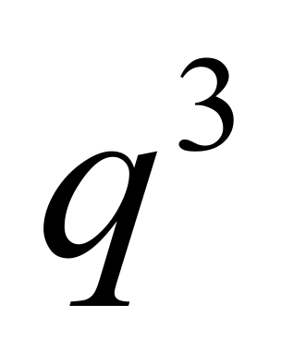
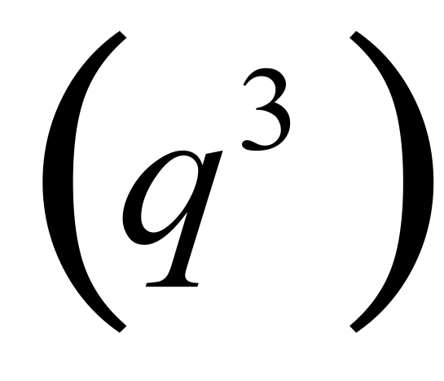
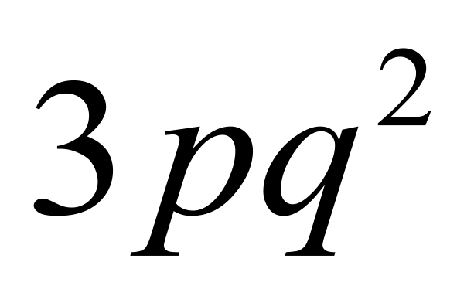
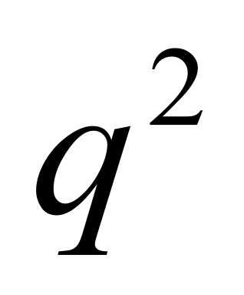
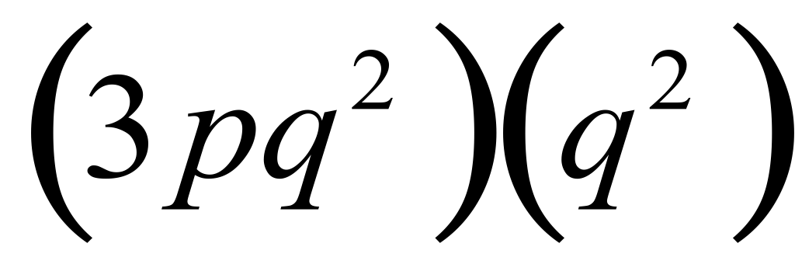
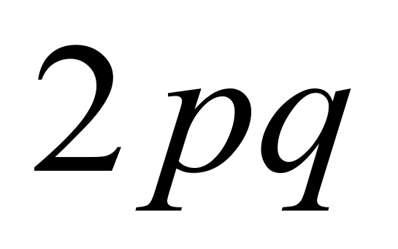
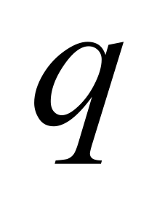
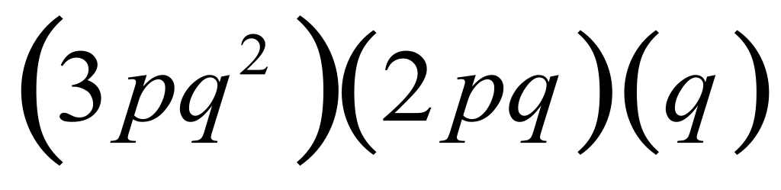

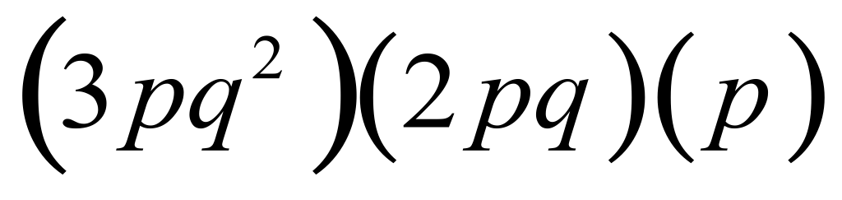
Reed-Frost: example with n=4
Infectious
Recovered
Probability:
Susceptible
Notes:
Single infection result in no transmissions
Talk through binomial for the first 2.

Slide 23
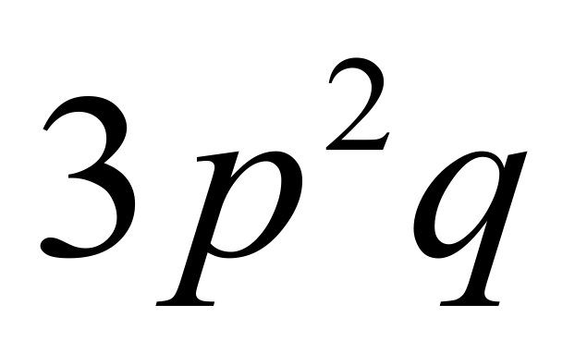
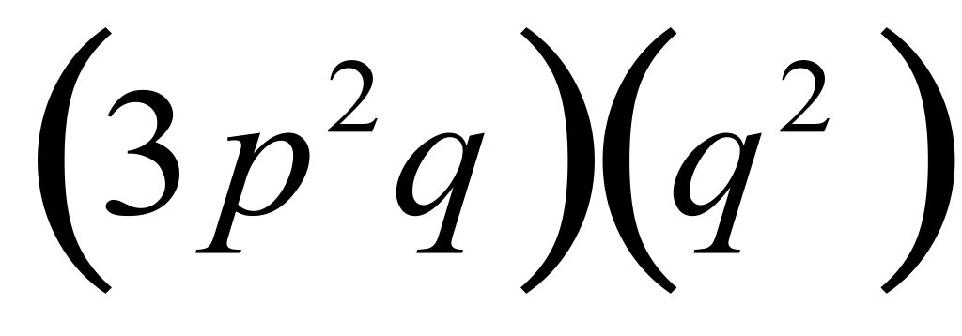
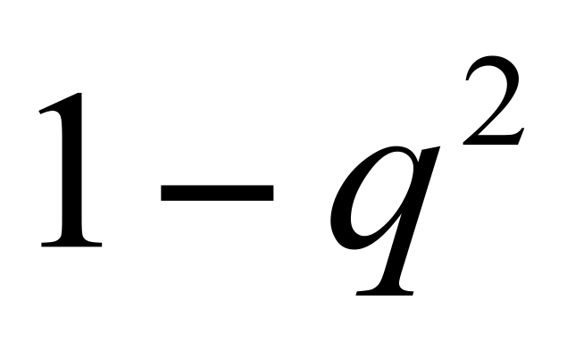
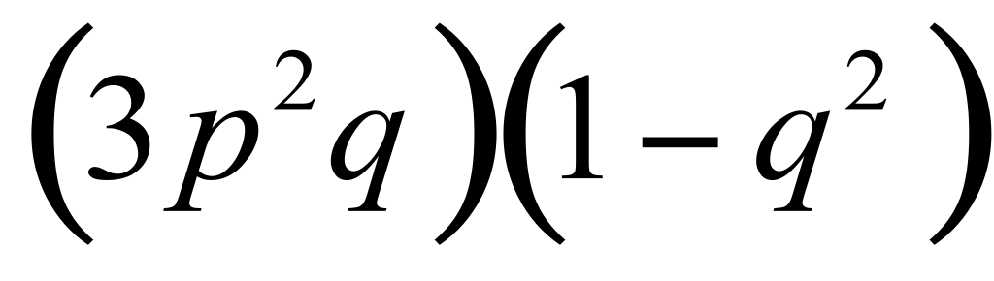
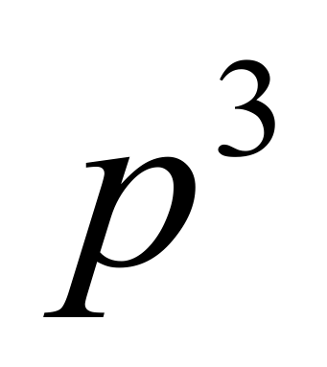
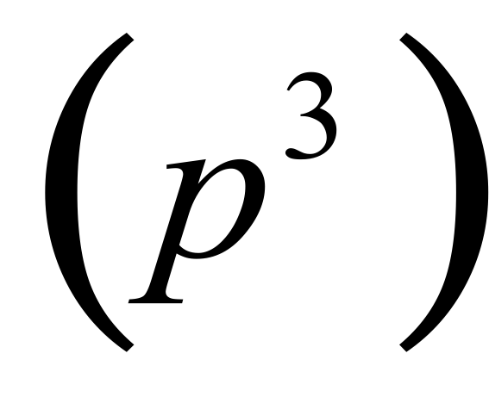
Reed-Frost: example with n=4 (2)
p
(3pq )(p )
2
2
2
Denote the 8 possible outcomes as:
(1-0), (1-1-0), (1-1-1-0), (1-1-1-1), (1-2-0), (1-2-1), (1-3), (1-1-2)
Notes:
Note line 3, 1-q^2, possibly confusing (see next slide)

Slide 24
Reed-Frost: example with n=4 (2)
Remember: must look at all possible Infected - Susceptible pairs
Probability of moving from SIIR → IRRR?
2
1
S
3 possible ways that the susceptible could become infected:
P(1 transmits & 2 doesn’t) = pq
P(1 doesn’t transmit & 2 does) = pq
P(1 transmits & 2 transmits) = p
2
P(SIIR → IRRR) = p + 2pq = 1 - q
2
2
Notes:
Can draw a probability tree - may make it clearer

Slide 25
An example R function
# Reed-Frost model:N = number of individuals per household;
# p = probability of a susceptible becoming infected per infected in the # household. Output: number of new infected at each generation.
aid.household <- function(p, N){
rtn <- c()
inf <- 1
sus <- N-1
while(inf > 0 && sus > 0){
newinf <- 0
for(i in 1:inf){
for(j in 1:sus){
if(runif(1) < p){
newinf <- newinf + 1
sus <- sus - 1
}
}
}
rtn <- c(rtn, newinf)
inf <- newinf
}
rtn
}
test <- replicate(100, aid.household(p=0.41, N=4), simplify="array")
head(test, n = 10) # view first 10 outputs
Notes:
Some R code… For interest.

Slide 26
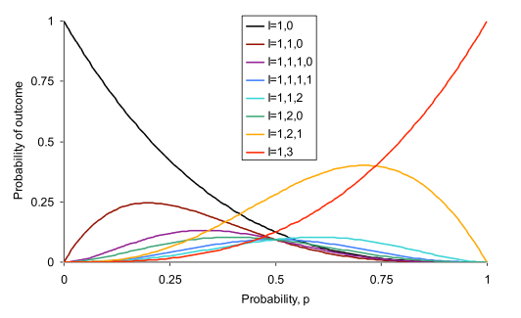
Reed-Frost: example with n=4 (3)
For a large range of parameters, all outcomes are almost equiprobable.
(1,0) most likely for p<0.41 (mumps), (1,2,1) most likely for 0.41<p<0.73 (chickenpox), then (1,3) most likely for p>0.73 (measles).
Notes:
Talk through the slide

Slide 27
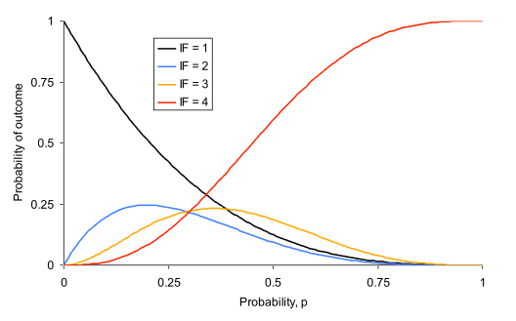
Reed-Frost: final size
Often difficult to distinguish generations, so focus on final size
(1,2,1)
(1,1,1,1)
(1,3)
(1,1,2)
(1,1,1,0)
(1,2,0)
(1,0)
(1,1,0)
For p>0.75, all infected becomes by far the most likely infected
Notes:
Circles - how we get final sizes of 1, 2, 3, 4. (ie total number of individuals within a household that get infected)
Plot: transmission probability of p (x-axis) yields a probability of outcome (y-axis) for different final size values.

Slide 28
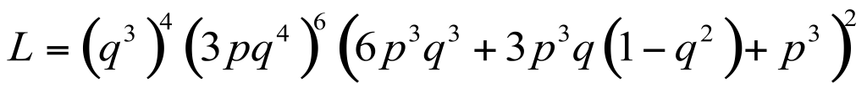
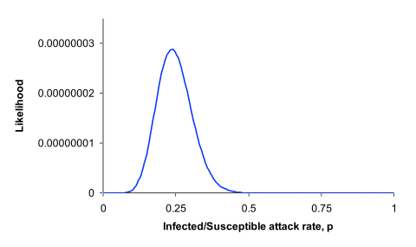
Reed-Frost: fitting to data
Example, Tecumseh study of H3N2 influenza, Longini et al, Am J Epi 1988.
Final number infected in households of size 4 where all are susceptible:
4 households had 1 case, 6 had 2, none had 3, and 2 had 4.
Likelihood is
→ influenza less infectious than mumps, attack rate ≈ 25%
Notes:
Example likelihood from the chain binomial calculations

Slide 29
Reproduction number for household models
Define RHV as number of households infected by one household.
Becker & Dietz (1995) calculate a reproduction number for households infecting houses, and compare with R0. Consider how an immunisation strategy may be affected. Find a (mathematical) condition for when immunising random individuals from the population is worse than immunising all individuals within a proportion of households.
https://projecteuclid.org/download/pdf_1/euclid.aoap/1034625252

Slide 30
Reproduction number for household models (2)
Can be estimated in real time in an epidemic (Fraser, PLoS One 2007).
Household reproduction number perhaps most useful if proposed interventions target households, eg quarantine, antivirals, etc
https://journals.plos.org/plosone/article?id=10.1371/journal.pone.0000758

Slide 31
Future challenges
Theory of household outbreaks well developed.
Would like to extend to overlapping static structures, i.e. household/workplace/school models.
Would also like to extend to multiple level hierarchies, i.e. households/village/district/region/country models.
More work needed on parameter estimation (especially between household transmission).

Slide 32
Inference with MCMC and data augmentation for infectious disease data
Ada Yan, Caroline Walters, Steven Riley
MRC Centre for Global Infectious Disease Analysis
Imperial College London
(Slides by Ada Yan and Oliver Ratmann, based on slides by Simon Cauchemez)

Slide 33
Accessing the practical
In RStudio, run devtools::install_github("c97sr/learnidd", build_opts = c("--no-manual"), force = TRUE)
  browseVignettes("learnidd")
  Click on transmission_inference (HTML)
  (Solutions are transmission_inference_ans)
  Backup link: http://bit.ly/2FF41qR

Slide 34
Learning outcomes
Understand why it is typically not straightforward to estimate transmission dynamics from outbreak data
Be able to explain what is meant by data augmentation
Be able to explain the Markov Chain Monte Carlo algorithm to estimate transmission dynamics
Be able to apply the data augmentation technique and MCMC inference on a toy example

Slide 35
Why fit a mechanistic model to ID data? How?
Why fit a mechanistic model to data?
  Example: H1N1pdm influenza school outbreak (Cauchemez et al. 2011): can answer questions such as
    How does H1N1pdm transmission differ in/between households; school; grade; classroom?
    Do sex related mixing patterns or seating arrangements affect transmission?
    Was school closure responsible to halt the outbreak?
How do we fit a model to data (i.e. estimate model parameters)?
  Write down the likelihood for model parameters given data
  Use an algorithm such as MCMC to sample from the posterior distribution of the parameters, given the data
How might we deal with missing data?
  Outbreak data is often incompletely observed. Missing data might be:
    Missing variables. E.g.:
      We know the time of symptoms onset;
      But we don’t know when, where, by whom a person was infected.
    Missing cases, censoring etc.
  Data augmentation techniques help us deal with missing data.
From theory to practice:
  You are going to analyze data from a transmission challenge study with data augmentation and MCMC techniques.

Slide 36
Part 1: Exploring the data
If using backup,
source(“households.R”)
data <- read.csv("data.txt", header = TRUE, sep = " ")

Slide 37
Part 2: Modelling incubation
Infection
Symptom onset
Donor 1
d₁
Infection
Symptom onset
Donor 2
d₂
Time

Slide 38

Part 2: Modelling incubation
MODEL
Density of incubation period
is the mean incubation period
0
Time
DATA
Infection
Symptom onset
Donor 1
d₁
Infection
Symptom onset
Donor 2
d₂
Different models have different functions for -- depends on the host and the pathogen
Time

Slide 39
Part 3: Intro to MCMC --
Estimating the incubation period
MODEL
Density of incubation period
is the mean incubation period
0
Time
DATA
Infection
Symptom onset
Donor 1
d₁
Infection
Symptom onset
Donor 2
d₂
CONTRIBUTION OF DONOR 1 TO LIKELIHOOD
Time

Slide 40
Part 3: Intro to MCMC --
Estimating the incubation period
MODEL
Density of incubation period
is the mean incubation period
0
Time
DATA
Infection
Symptom onset
Donor 1
d₁
Infection
Symptom onset
Donor 2
d₂
LIKELIHOOD OVER ALL DONORS
product symbol: multiply over all where is the donor index

Slide 41
Part 3: Intro to MCMC --
Estimating the incubation period
LIKELIHOOD OVER ALL DONORS
product symbol: multiply over all where is the donor index
LOG LIKELIHOOD

Slide 42
MCMC - basics
We want to estimate the posterior distribution of the parameters, that is the probability density function of the parameters given the data. The posterior distribution is given by
Posterior distribution
Likelihood
Prior distribution
The posterior distribution is a concept in Bayesian statistics. It incorporates both the likelihood (the probability of observing the data given model parameters) and the prior distribution (existing information we have about likely parameter values). In this practical we will use a uniform prior, i.e. assume no existing information.
Markov Chain Monte Carlo is one algorithm to sample from the posterior distribution.
It is an iterative algorithm, where each iteration produces one sample from the posterior distribution.
Notation notes: bold = vector of 1+ values, normal font = single value. Aaaa aaaaaaaaaaaaaaa= parameter values, = data.

Slide 43
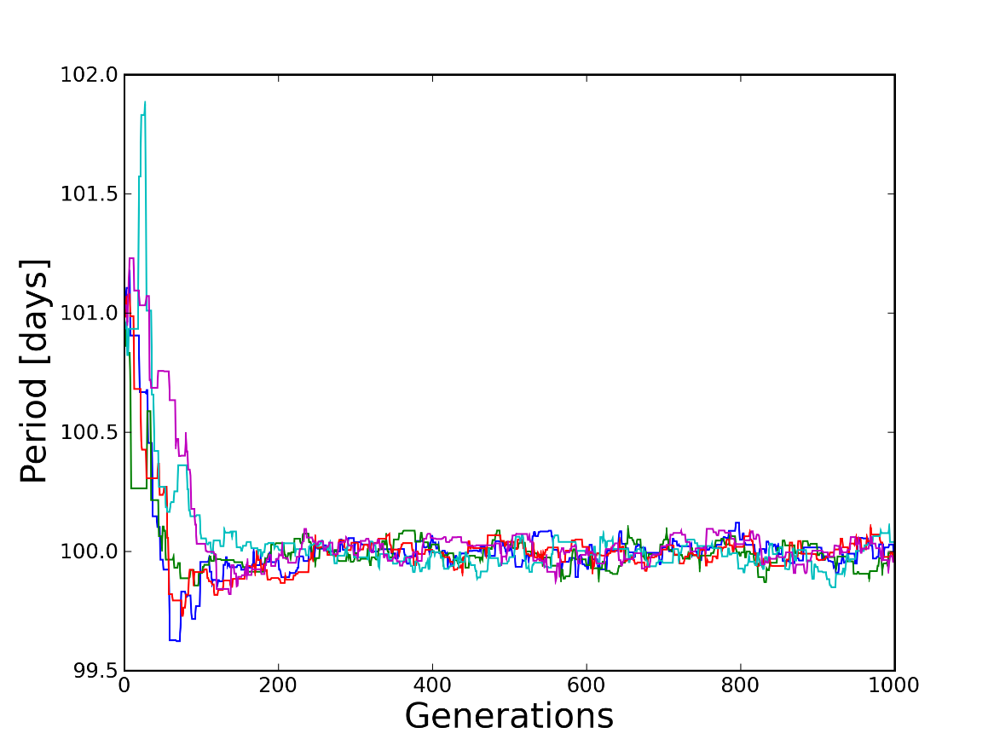
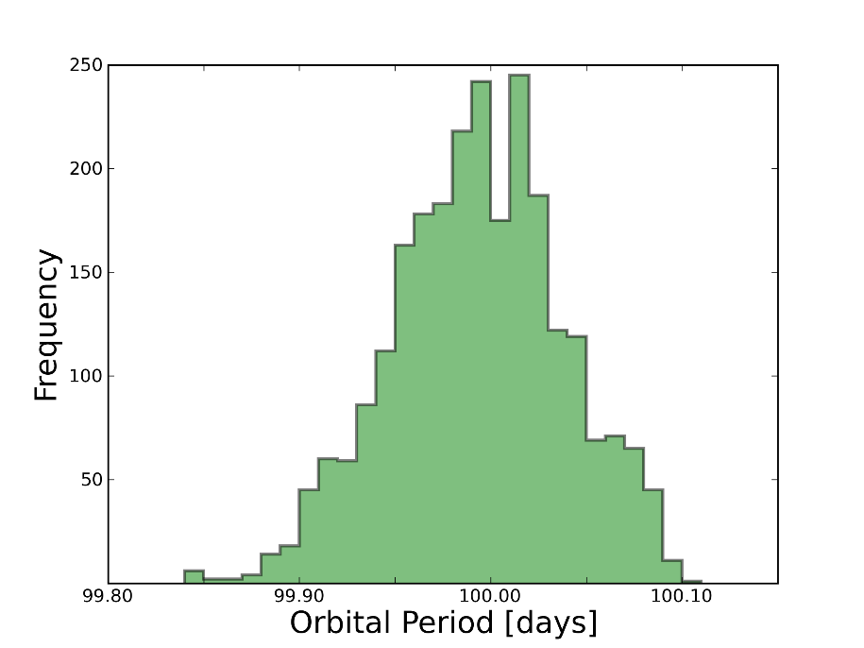
MCMC - basics
Markov Chain Monte Carlo is one algorithm to sample from the posterior distribution.
It is an iterative algorithm, where each iteration produces one sample from the posterior distribution.
Parameter value
Parameter value
Numerical approximation to posterior distribution
Iteration

Slide 44

MCMC – basic algorithm
Choose a starting point in parameter space, .
Set the current parameter values, , to .
For each iteration i = 2:N {
For each parameter k = 1:K {
Set the proposed parameters to , then draw a new value for the kth component of , , from a symmetric proposal distribution .
Calculate the value of the posterior distribution at the old and new parameter values, a and .
Accept the new value if (i.e. the new value is more likely). Otherwise accept the new value with probability .
If the new value was accepted, set . Otherwise stays at its current value.
}
Record the current value of the chain, .
}

Slide 45
MCMC visualisation
https://chi-feng.github.io/mcmc-demo/app.html#RandomWalkMH,standard

Slide 46
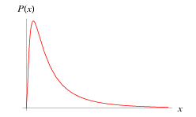
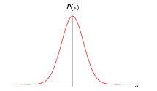
MCMC – non-symmetric proposal distribution
So far we have assumed a symmetric proposal distribution. That is, the probability of proposing value y if I am currently at value x is the same as the probability of proposing value x if I am currently at value y.
Sometimes it’s useful to use a non-symmetric proposal distribution. e.g. if want parameter values to be positive, we can have a normally distributed proposal distribution in log space. But this distribution is not symmetric in “normal” space. In this case we need to alter the algorithm slightly.
Normal distribution Lognormal distribution
Notes:
update

Slide 47

MCMC – non-symmetric proposal distribution
Non-symmetric proposal distribution (e.g. normal distribution in log space):
Choose a starting point in parameter space, .
Set the current parameter values, , to .
For each iteration i = 2:N {
For each parameter k = 1:K {
Set the proposed parameters to , then draw a new value for the kth component of , , from a proposal distribution .
Calculate a and .
Accept the new value if . Otherwise accept the new value with probability .
If the new value was accepted, set . Otherwise stays at its current value.
}
Record the current value of the chain, .
}

Slide 48


MCMC – non-symmetric proposal distribution
Derivation of ratio of proposals (just for interest)
Random walk on log-scale:
This is equivalent to say that
θ* is drawn from Log-normal distribution
with log mean and log sd σ
and density
with u~Norm(0,1)
The ratio of proposals is therefore

Slide 49
MCMC – postprocessing
At the start, the MCMC chain is far away from the likely region of parameter space. Hence discard early iterations (“burn-in”)
Parameter values from consecutive iterations are correlated. To save storage space, can only keep every nth iteration e.g. every 5th iteration (“thinning”)
Run multiple chains to see if they reach the same region of parameter space -- sometimes a chain can get stuck and look like it’s converged when it hasn’t. (Won’t cover today)
burn-in
Parameter value
thin
Iteration

Slide 50
Part 4: modelling transmission
COMPLETE DATA
Infection
Symptom onset
Donor 1
d₁
Recipient 1
t₁
r₁
Donor 2
d₂
Recipient 2
Time
Ideally we would observe the time of infection of the donor (t = 0) and the recipient, and the time of symptom onset of the donor and recipient.
In practice we don’t know the time of infection of the recipient -- more later

Slide 51

Part 4: modelling transmission
MODEL
Density of incubation period
is the mean incubation period
0
Time
Hazard function
is the transmission parameter and controls the height of the curve
0
Time
is the mean incubation period and controls the width of the curve
The hazard function describes the risk of transmission at a given time since infection
(probability of infection between [t,t+dt] given not infected up to time t is h(t)dt)

Slide 52

Part 4: modelling transmission
Hazard function
0
t
The hazard function describes the risk of becoming infected at time t since infection of the donor
and friends
Cumulative hazard function
Survival function
0
t
0
t
The cumulative hazard function describes the total risk of having become infected at time t since infection of the donor
The survival function describes the probability of escaping infection up to time t since infection of the donor

Slide 53
Part 4: modelling transmission
CONTRIBUTION TO LIKELIHOOD FROM PAIR WHERE TRANSMISSION OCCURRED
Infection
Symptom onset
Donor 1
d₁
Recipient 1
t₁
r₁
Time
C₁ = probability of donor’s incubation period x
probability of recipient escaping infection up to t₁ x
probability recipient gets infected at t₁ x
probability of recipient’s incubation period
=
are the model parameters

Slide 54
Part 4: modelling transmission
CONTRIBUTION TO LIKELIHOOD FROM PAIR WHERE TRANSMISSION DID NOT OCCUR
Donor 2
d₂
Recipient 2
Time
C₂ = probability of donor’s incubation period x
probability of recipient escaping infection indefinitely
=
In practice, calculate as e.g.

Slide 55


Part 4: modelling transmission
Infection
Symptom onset
Donor 1
d₁
Recipient 1
t₁
r₁
Donor 2
d₂
Recipient 2
CONTRIBUTION TO LIKELIHOOD FROM ALL TRANSMISSION PAIRS
product symbol: multiply over all where is the cluster index
LOG LIKELIHOOD

Slide 56
Part 4: modelling transmission
Infection
Symptom onset
Donor 1
d₁
Recipient 1
t₁
r₁
Donor 2
d₂
Recipient 2
LOG LIKELIHOOD
Problem: unobserved transmission times t_{i}

Slide 57
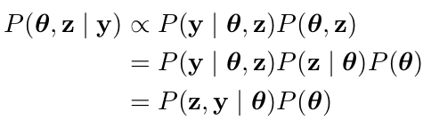
Part 5: Data augmentation
Problem: unobserved transmission times t_{i}
Solution: infer transmission times t_{i} (as if they are extra parameters) by “augmenting” the data.
General notation: = augmented data.
‘augmented likelihood’: easy to evaluate

Slide 58


DA and MCMC
Choose a starting point in parameter space, , and initialise the augmented data, .
Set the current parameter values, , to , and the current augmented data, , to .
For each iteration i = 2:N {
For each parameter k = 1:K {
Set the proposed parameters to , then draw a new value for the kth component of , , from a proposal distribution .
Calculate a and .
Accept the new value if Otherwise accept . Otherwise accept the new value with probability .
If the new value was accepted, set . Otherwise stays at its current value.
}
For each augmented value m = 1:M {
Set the proposed augmented values to , then draw a new value for the mth component of , , from a proposal distribution .
Calculate a and .
Accept the new value if . Otherwise accept Otherwise accept the new value with probability .
If the new value was accepted, set . Otherwise stays at its current value.
}
Record the current value of the chain, .
}

Slide 59
Part 6: Further analysis of samples from the posterior distribution

Slide 60
Discussion
Missing data in outbreaks make inference challenging.
Data augmentation and MCMC:
  Major development for analysis of infectious disease data of the last 15 years;
  Can tackle very complex problems.
Further reading:
  Ravenzwaaij et al. (2018) A simple introduction to Markov Chain Monte–Carlo sampling, Psychonomic Bulletin and Review
  Gilks, Richardson, Spiegelhalter (1996) Markov Chain Monte Carlo in practice
  Cauchemez et al. (2011) Role of social networks in shaping disease transmission during a community outbreak of 2009 H1N1 pandemic influenza, PNAS
  Cauchemez et al. (2004) A Bayesian MCMC approach to study transmission of influenza: application to household longitudinal data, Stat Med
  Ypma et al. (2012) Unravelling transmission trees of infectious diseases by combining genetic and epidemiological data, Proc Roy Soc B

